Slide 1




FIRST PORTFOLIO
PROJECT PRESENTATION
Talha Javaid

Slide 2
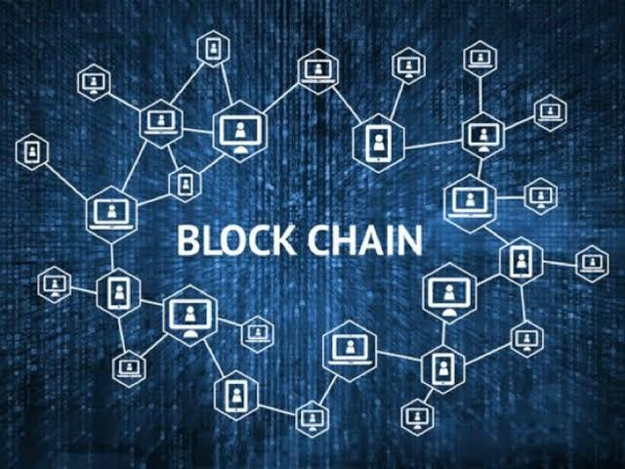
MY INTRODUCTION
Name: Talha Javaid
Email: talhajavaid111@gmail.com
Cell# 03040318500
Course Enrolled: Blockchain Developer
Course Instructor: Mr. Umer Aqeel
Cohort # 03
Institutes of Emerging Careers ( IEC)
Github: https://github.com/Talha-Javaid
LinkedIn: www.linkedin.com/in/talhajavaidmalik

Slide 3
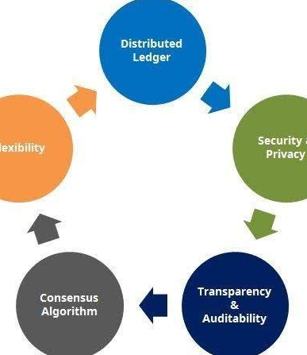
PROJECT TITLE
Blockchain Based Land Registry System to Remove Frauds, Intermediaries and Brokers.
10K+

Slide 4


ABSTRACT
The land registry system is one of the very important department in any governance system that stores the records of land ownership. There are various issues and loopholes in the existing system that give rise to corruption and disputes. This requires a significant chunk of valuable government resources from judiciary and law enforcement agencies in settling these issues.
Blockchain technology has the potential to counter these loopholes and sort out the issues related with land registry system like tempering of records, trading of the same piece of land to more than one buyer. In this project a secure and reliable framework for land registry system using Blockchain has been implemented.
The framework uses the concept of smart contract at various stages of the land registry and gives an algorithm for pre-agreement. First, the conventional land registry system in Pakistan and the issues are highlighted. Then, I jave outlined the potential benefits of employing Blockchain technology in the land registry system and presented a framework.

Slide 5
Current Land Registry System in Pakistan
In Pakistan and other parts of the world land registration process and maintenance is too tedious since it involves safekeeping of large volumes of registers in written form.
The main issue with the above-mentioned method of land registry maintenance is that any future reference that needs o be taken from these hard copies will involve too much labour. This process is time consuming.
Also the current system is not secured since majority of the process is not transparent, system is slow, and selling a property more than once needs to be recorded accurately. Several approaches have been made to automate the land registry data maintenance by eliminating the process of keeping bookish records. This is initially done by storing the data in huge databases. But such a method is not efficient in terms of data security as the data contents are breached easily as data tampering can happen in case of poorly maintained databases.

Slide 6
Involvement of middlemen and brokers
Increasing number of fraud cases
CHALLENGES IN THE EXISTING LAND REGISTRY PROCESS
Human error or Intervention
Time Delays

Slide 7
How Blockchain can help?
Blockchain is a distributed ledger technology that keeps historical record of all transactions that have taken place across a peer-to-peer network. Implementing land registry using blockchain helps in avoiding fraudulent activities thereby making the system more secure. Since it is difficult to duplicate the blockchain.
Implementing land registry using this technology helps in avoiding any illegal activities involved in land transactions. Contracts and ownership details are maintained in a decentralized method. It is easier to track the data transaction from the block chain implementation as it eliminates the need for physical intervention and thus improves the overall security for users of the system. Blockchain provides an opportunity to establish a strong system for digital identity.
Using blockchain, each block in the network represents the data involved in a land transaction which includes details like property id, property number, owner details, transaction amount, mode of payment and last transaction details such as amount that has been paid for that transaction. By the proper use of blockchain technology we can ensure data protection as well as systematic arrangement of data collected.

Slide 8
Benefits of Implementing Blockchain Technology
01
Accelerating the Process
03
Reducing Fraud Cases
Blockchain based land registry system can offer you a distributed database where anyone can record and access information without the involvement of any centralized authority.
Blockchain keeps an immutable record of transactions, hence blockchain can prove that you are the owner of the land title and prevent from forgery of documents.Therefore, it can be said that the blockchain land registry platform could serve as proof of ownership, existence, exchange and transaction.
Bringing Transparency with Smart Contracts
02
04
Reducing Human Intervention
Blockchain makes ownership transfer seamless and quicker than the traditional method.As soon as the registrar confirms the transfer of land title, smart contracts trigger to update ownership for a new buyer and transaction corresponding to it gets stored on the blockchain.In this way, it is always possible to trace back the history of ownership records.
Blockchain based land registry system solves the problems occurred due to human errors and interventions. In this way blockchain is eliminating the chances of errors in the land registry system.

Slide 9
TOOLS USED
Ethereum Blockchain
Remix Ide
Solidity Smart Contract

Slide 10
Buyer
STAKEHOLDERS
A person who buys the land by searching the property, request access and interact with the seller and get the land title ownership.
INVOLVED IN THE BLOCKCHAIN LAND REGISTRY PLATFORM:
Seller
A person who sells the land and uses the platform to manage properties and transfer land title to buyers.
LandInspector
A person who is the owner of the contract and uses the platform to manage property requests, verify buyers, sellers and lands, confirm and initiate the transfer.

Slide 11
Stepwise Approach for Land Registration
Step 1: LandInspector is the owner of this contract .
Step 2: A seller who wants to sell his land registers with seller details.
Step 3: LandInspector can either verify that seller or reject that seller.
Step 4: If seller is verified then seller upload land details.
Step 5: LandInspector will also verify the land added by seller by landID.

Slide 12
Step 6: A buyer who wants to purchase land registers with Buyer details.
Step 7: LandInpector either verify that Buyer or reject that buyer.
Step 8: We can check if Buyer or Seller is verified or not.
Step 9: We can check who is the current owner of this land.
Step 10: Buyer can buy the land only if buyer and land both is verified buyer need to give the amount and landid to buy.
Step 11 : Owenrship will change to current owner to newOnwe
Step 12: Owner of the land can transfer their land to any address if the is land is verified by landInspector.

Slide 13
Conclusion
Blockchain based land registry system proposed a seamless, easy to use and hustle-free platform which can be used for making the land registration easy. There are many problems such as involvement of brokers or middleman, time delays, etc. This system will eliminate the problems associated with land registration in Pakistan as well as in many parts of the world. The steps involved in the process of land registration are discussed in smart contract. Making land registration paperless will not only make the process easier but also secure the papers of ownership of land from various man-made and natural disasters. The blockchain technology is emerging very rapidly due to secure features it offer. Hence using blockchain to save the land record transaction is the way to create the immutable records. There are many additional features that can be added to the platform of land registry. Nowadays, land is not a liquidated asset. By using the platform land assets can also be liquidated using the cryptocurrency, that maps with the land record created by a seller on the platform. Hence the scope is wide and there can be many use cases of the platform created.

Slide 14
GITHUB REPOSITORY LINK:
HTTPS://GITHUB.COM/TALHA-JAVAID
GITHUB LAND REGISTRY PROJECT LINK:
HTTPS://GITHUB.COM/TALHA-JAVAID/BLOCKCHAIN-BASED-LAND-REGISTRY-SYSTEM-TO-REMOVE-FRAUDS-INTERMEDIARIES-AND-BROKERS
+923040318500
talhajavaid111@gmail.com
GitHub.com/Talha-javaid

Slide 15
THANK YOU
FOR YOUR TIME
+923040318500
talhajavaid111@gmail.com
GitHub.com/Talha -Javaid

